Slide 1
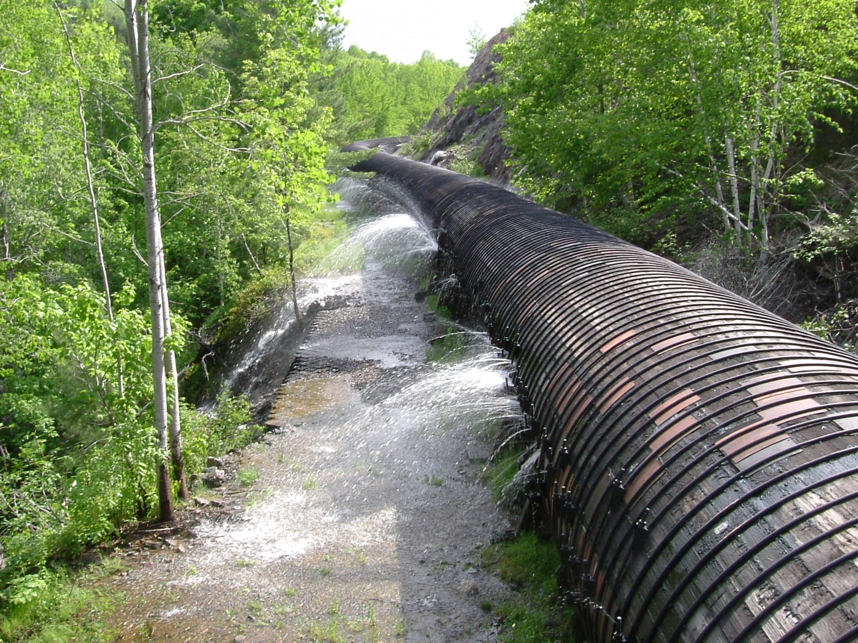
Is your API leaking? Breaking APIs to increase security.
Joe Kuemerle / @jkuemerle / www.kuemerle.com
https://www.flickr.com/photos/krisgriffon/18786084/

Slide 2
Joe Kuemerle
Many years of development experience with a broad range of technologies
Focused on application and data security, coding best practices and regulatory compliance
Presenter at community, regional and national events.
http://twitter.com/jkuemerle
Notes:
Background

Slide 3

https://www.flickr.com/photos/arthurtlabar/7983314496/
Notes:
We can envision our API as pipelines delivering digital goodness to our users. Pipelines need to be strong and able to contain their contents as well as keeping outside contaminants out.

Slide 4

https://www.flickr.com/photos/woodhead/6950573661/
Notes:
In order to work correctly the pipeline must be built correctly and well maintained. Containment failures can have serious consequences.

Slide 5
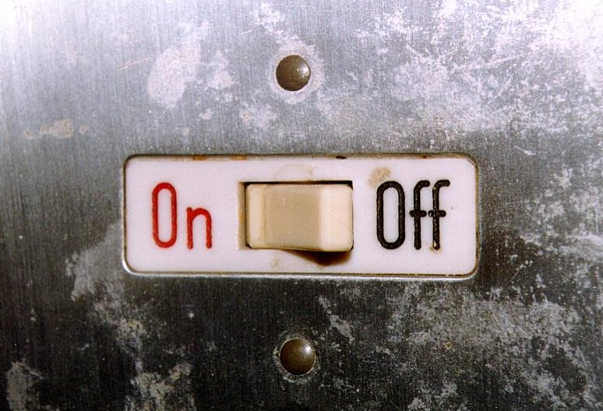
https://www.flickr.com/photos/centralasian/5565136539/
Notes:
When attempting to build a "secure" anything remember that security is not an on/off switch

Slide 6
Convenience
Security
Notes:
It is a spectrum with security/convenience tradeoff

Slide 7
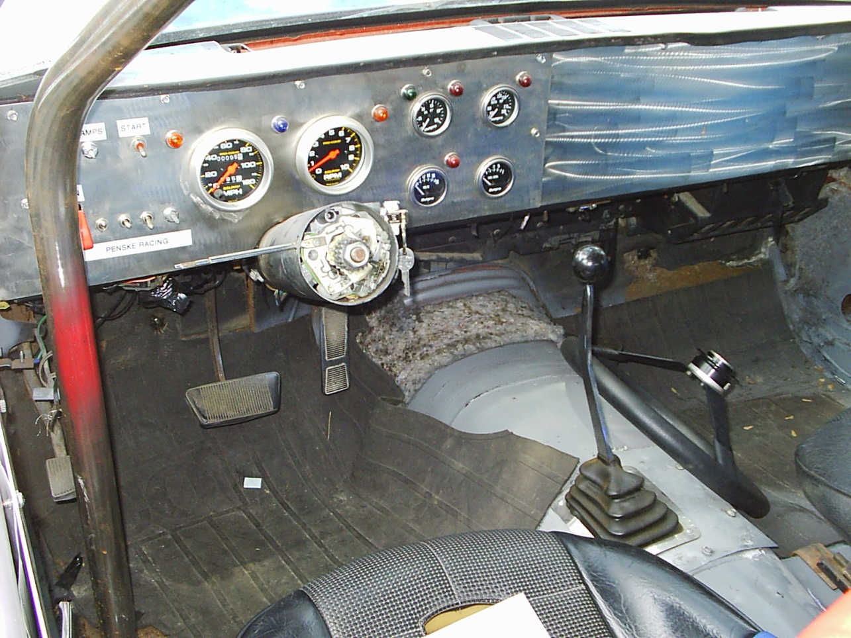

https://upload.wikimedia.org/wikipedia/commons/e/ec/1974_AMC_Matador_grand_national_int.jpg
https://www.flickr.com/photos/dahlstroms/4511228299/
Notes:
Real world examples: door locks are less convenient but stop casual theft, cars have anti-theft measures. Nothing is completely secure. Goal is to raise the bar high enough so that attackers look elsewhere.

Slide 8
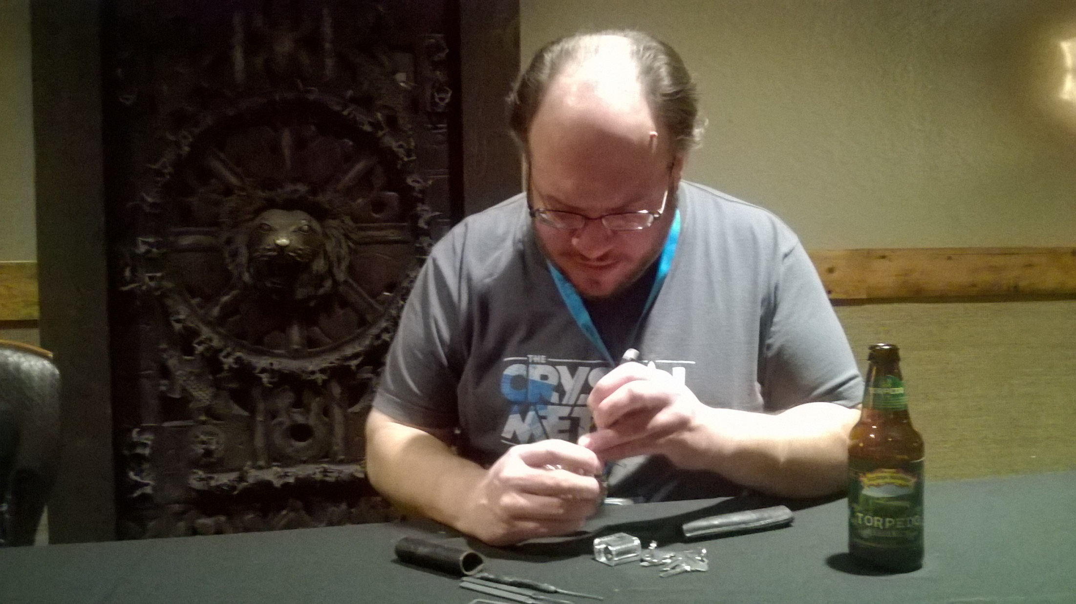
Notes:
Even locks have their vulnerabilities

Slide 9

https://www.flickr.com/photos/aukirk/13049646504/
Notes:
Security is not something that can be easily or cheaply added after the fact. You can't just sprinkle security on.

Slide 10

https://www.flickr.com/photos/if-by-whiskey/3203756823/
Notes:
Security should be baked in/deeply embedded and should permeate the entire system. Security awareness should be a goal of all phases of design, development and operation. Build security into projects and ensure they will be able to adapt over time.

Slide 11

http://bit.ly/1kMa4ea
Notes:
Remember you are being watched. More secure APIs can result in more stable, better documented applications. there are benefits beyond security

Slide 12

https://www.flickr.com/photos/chrisjohnbeckett/15475991686/
Notes:
Transport security / cleartext - there is a reason we don't ship money around in open pickup trucks

Slide 13
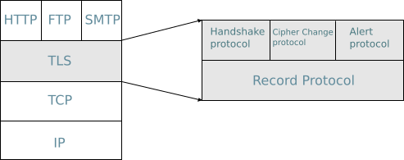
https://commons.wikimedia.org/wiki/File:TLS_protocol_stack.jpg
Notes:
Explanation of TLS

Slide 14
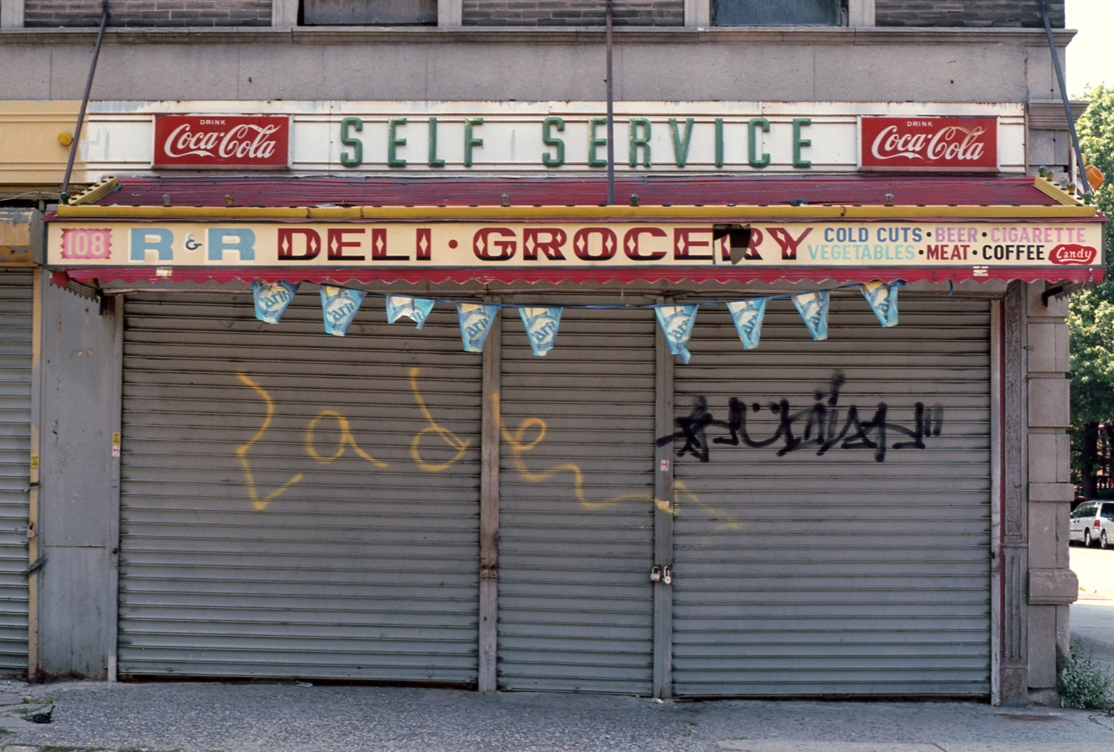

https://www.flickr.com/photos/shawnhoke/7563591726/
Notes:
TLS w/ self signed certs
TLS with real certs

Slide 15
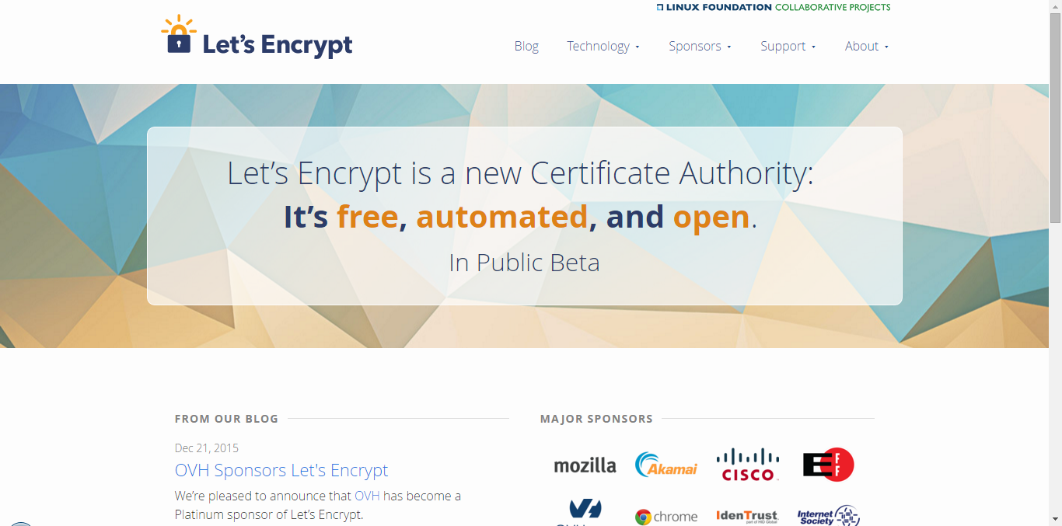
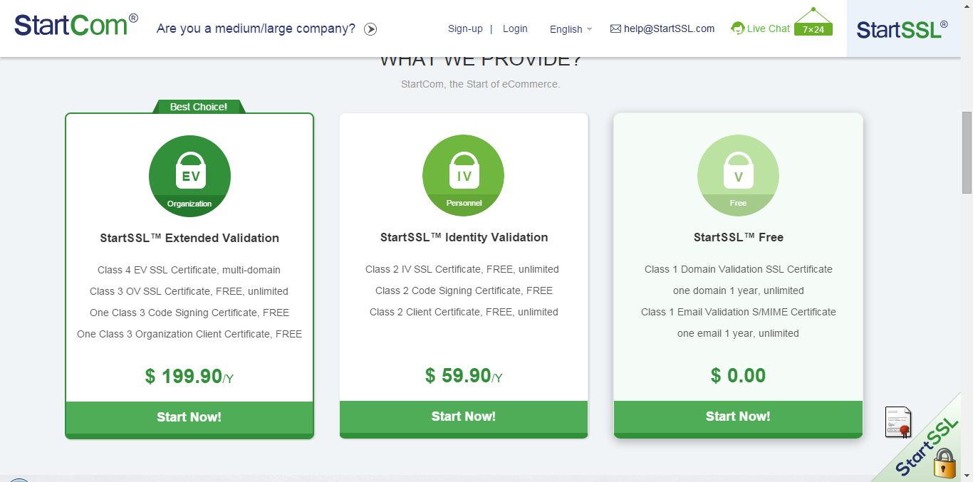
https://letsencrypt.org/
https://www.startssl.com/
Notes:
Free certs (startssl, letsencrypt)

Slide 16
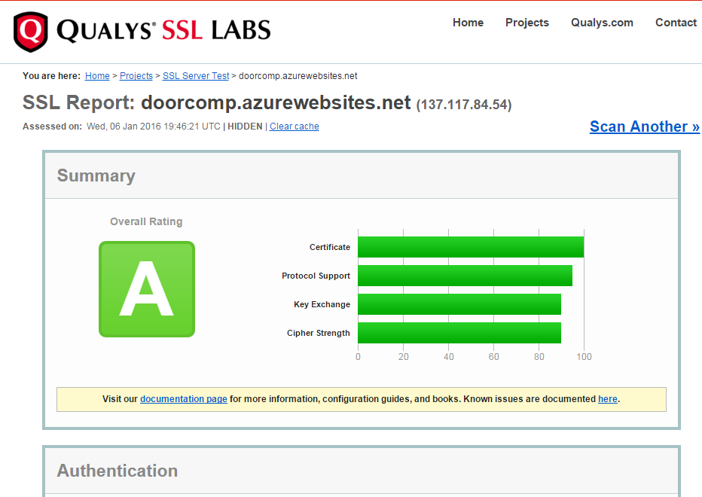
Notes:
TLS versions (POODLE (cypher fallback), Qualsys SSL reports)

Slide 17

Bypass Certificate Validation? DO NOT EVER DO THIS
(void)connection:(NSURLConnection *)connection didReceiveAuthenticationChallenge:(NSURLAuthenticationChallenge *)challenge {
[challenge.sender useCredential:[NSURLCredential credentialForTrust:challenge.protectionSpace.serverTrust] forAuthenticationChallenge:challenge];
[challenge.sender continueWithoutCredentialForAuthenticationChallenge:challenge];
}
SSLContext sc = SSLContext.getInstance("TLS");
sc.init(null, new TrustManager[] { new TrustAllX509TrustManager() }, new java.security.SecureRandom());
HttpsURLConnection.setDefaultSSLSocketFactory(sc.getSocketFactory());
HttpsURLConnection.setDefaultHostnameVerifier( new HostnameVerifier(){
public boolean verify(String string,SSLSession ssls) {
return true;
}
});
ServicePointManager.ServerCertificateValidationCallback = delegate(Object obj, X509Certificate certificate, X509Chain chain, SslPolicyErrors errors)
{
return (true);
};
Notes:
Certificate issues (self signed certs vulnerabilities , cert validation disabling)

Slide 18

https://www.flickr.com/photos/jasohill/3031344752/
Notes:
Better way is to use good certs and implement cert pinning)

Slide 19
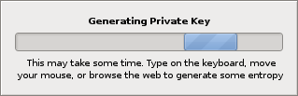
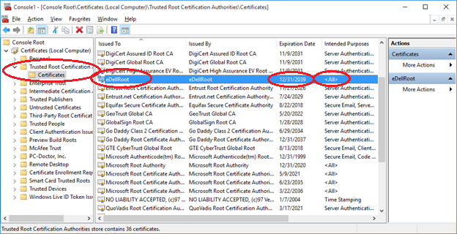
https://www.flickr.com/photos/barisione/2179852655/
Notes:
Other certificate gotchas, certificates with private keys on client machines, Dell CA certificate w/ private key

Slide 20

https://www.flickr.com/photos/yer_sister/543799566/
Notes:
MITM eavesdropping with disabled cert validation, MITM on open wifi

Slide 21

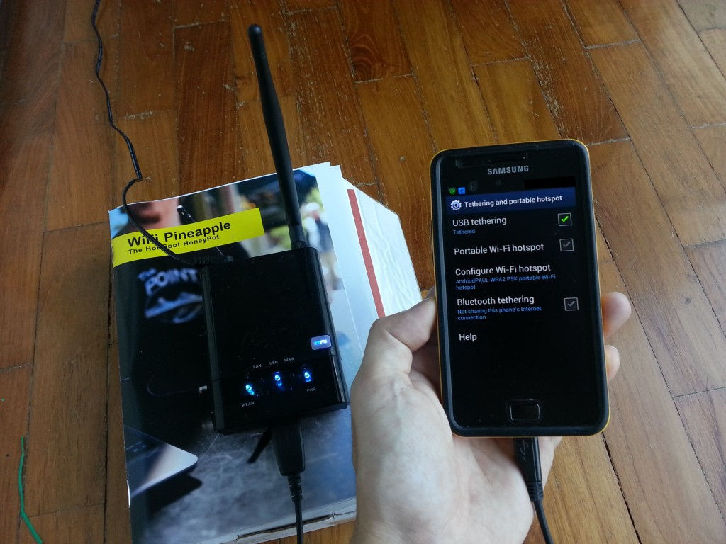
https://www.pinterest.com/pin/299630181430215484/
http://www.edgis-security.org/wireless-security/wifi-pineapple-first-impression/

Slide 22

ShipBattle!
https://www.flickr.com/photos/fredsitt/9818423086/
Notes:
Demo ShipBattle

Slide 23

https://www.flickr.com/photos/rushen/16491810210
Notes:
Demo Fiddler, discuss Burp & Zed Attack Proxy

Slide 24
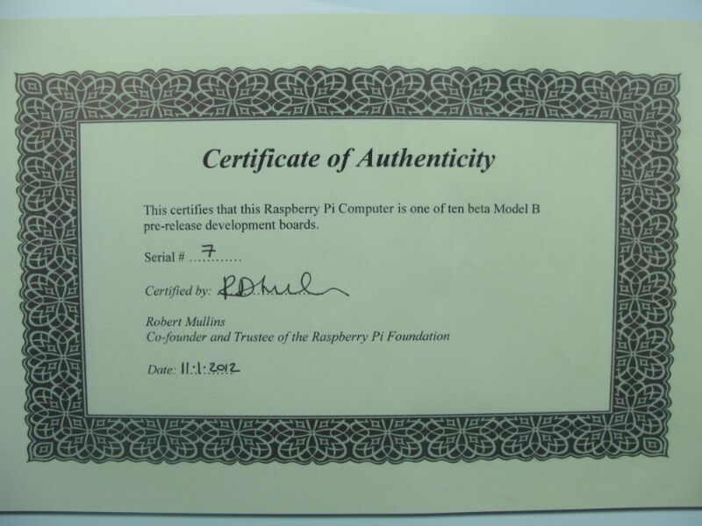
https://www.flickr.com/photos/97591625@N00/7020152239
Notes:
Authentication, how do you tell someone/something is what they say they are?
- no authentication
- basic auth with static credentials
- basic auth over HTTP (attack header)

Slide 25
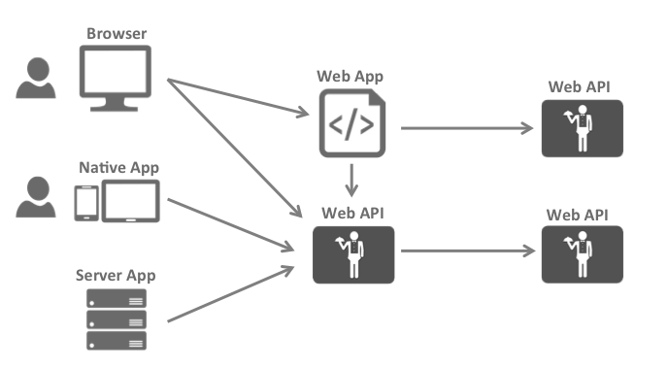
https://identityserver.github.io/Documentation/docsv2/overview/bigPicture.html

Slide 26
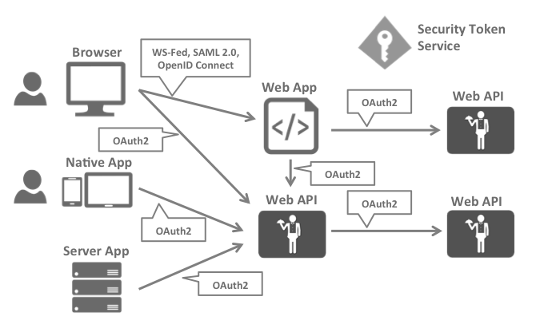
https://identityserver.github.io/Documentation/docsv2/overview/bigPicture.html

Slide 27
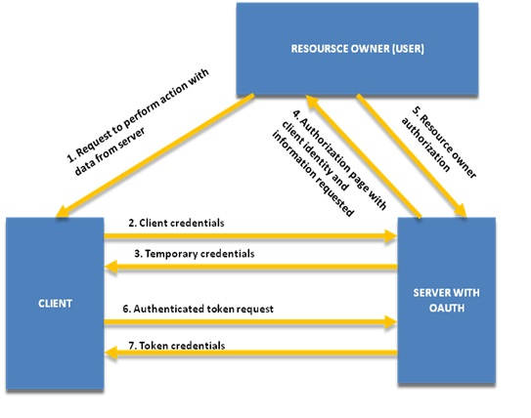
Notes:
- Oauth workflow

Slide 28
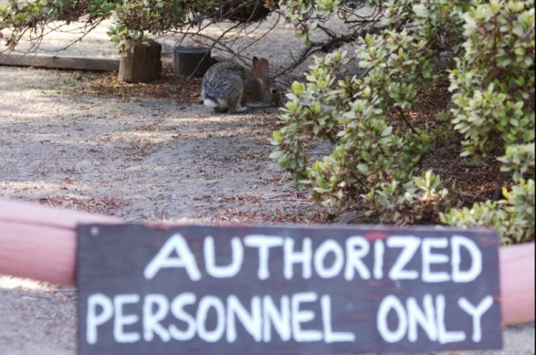
https://www.flickr.com/photos/mrbendy/227710896
Notes:
Authorization
- ensure authentication checks are performed
- don't trust user input (auth token + username manipulation)
Session persistence - where/how to persist, renewal tokens, tradeoffs for token expiration time versus convenience

Slide 29
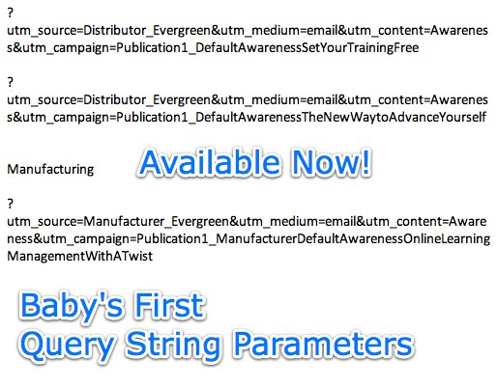
https://www.flickr.com/photos/caseorganic/2803957237/
Notes:
Parameters in GET requests - insecure because of MITM, server logs, browser history and copy/paste/forward

Slide 30
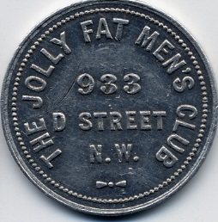
https://www.flickr.com/photos/rock_creek/5327104661/
https://auth0.com/blog/critical-vulnerabilities-in-json-web-token-libraries/
Notes:
JWT
JWT validation vulnerabilities: token validation with “none” algorithm, use public key as HMAC key

Slide 31

https://www.flickr.com/photos/underactive/4641141770
Notes:
Response manipulation
- elevate privileges

Slide 32

https://www.flickr.com/photos/132604339@N03/22724469359/
Notes:
Injection attacks. Describe injection attack. Mixing of command and data channels.
Why do we keep talking about injection attacks? How many have been/will be at other security sessions?

Slide 33
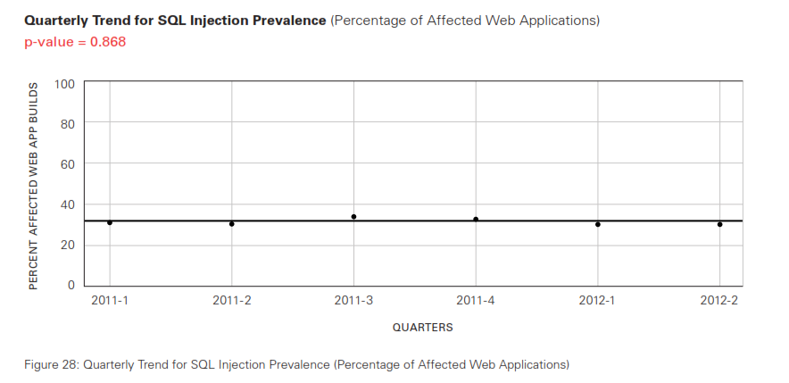
http://www.veracode.com/resources/state-of-software-security
Notes:
This is why.

Slide 34
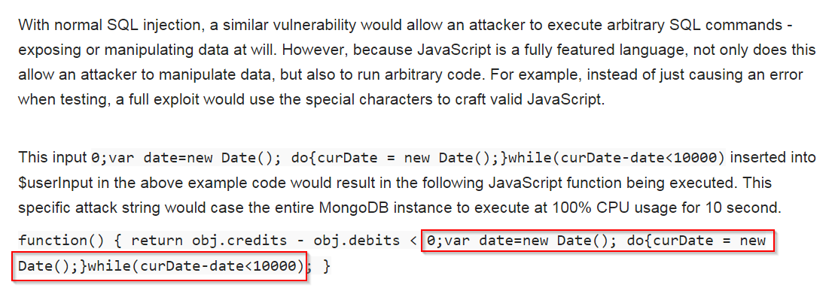
https://www.owasp.org/index.php/Testing_for_NoSQL_injection
Notes:
NoSQL injection vulnerability
NoSQL injection detailed

Slide 35
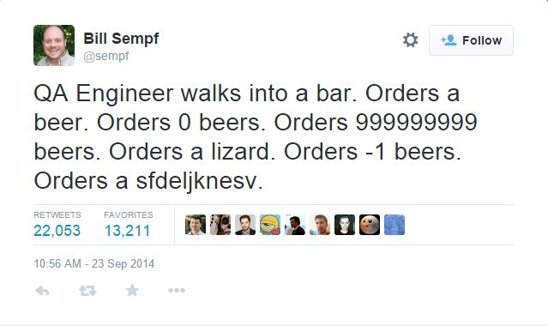
Notes:
QA - Sempf QA
Fuzz testing
- Fiddler fuzz

Slide 36
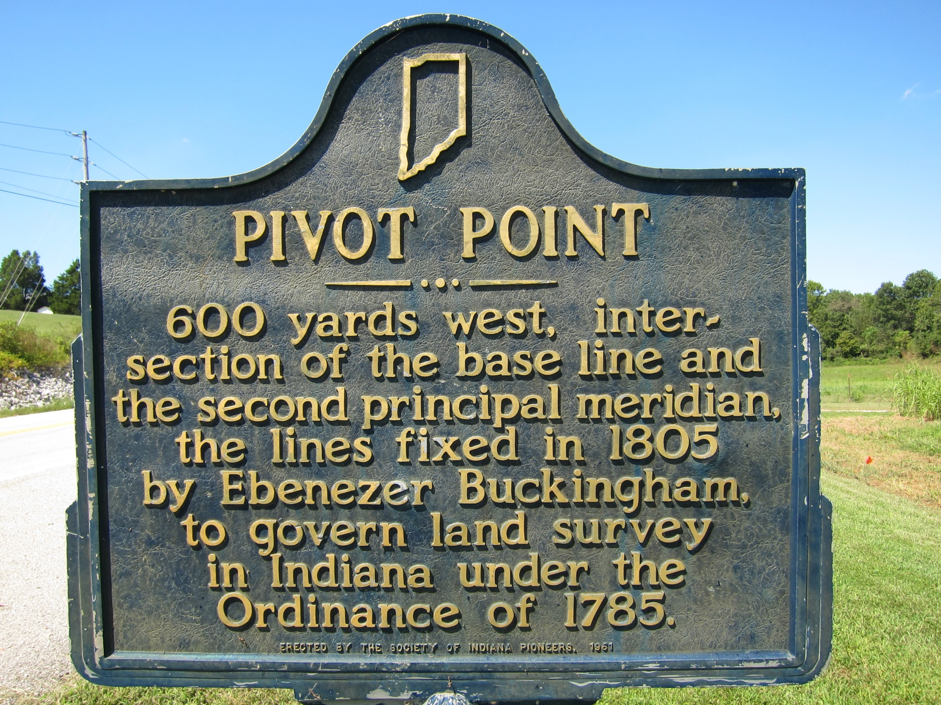
https://www.flickr.com/photos/hystericalmark/4906298122
Notes:
API as an attack pivot point for attacking other internal systems / least privilege on both client and server

Slide 37
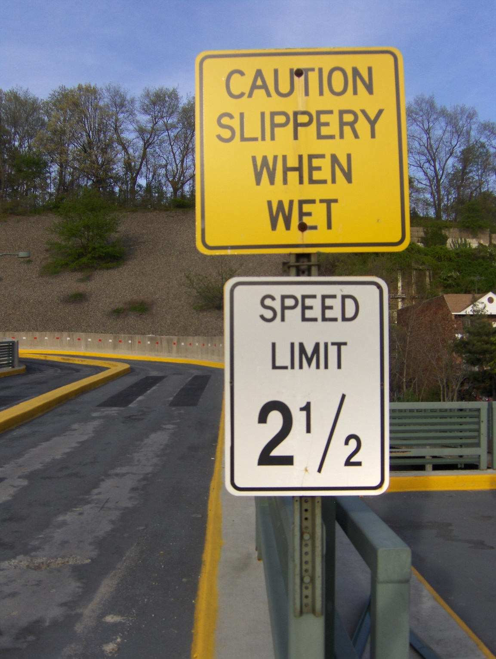
https://www.flickr.com/photos/joeshlabotnik/497312470/
Notes:
Enumeration and rate limiting defenses, GitHub API attack

Slide 38

https://www.flickr.com/photos/kevinomara/3422866722/
Notes:
Data storage

Slide 39

http://www.moserware.com/2009/09/stick-figure-guide-to-advanced.html
Notes:
User secrets, use platform crypto with unique encryption keys (not shared or static keys)
Major points: algorithm, mode, key, IV

Slide 40
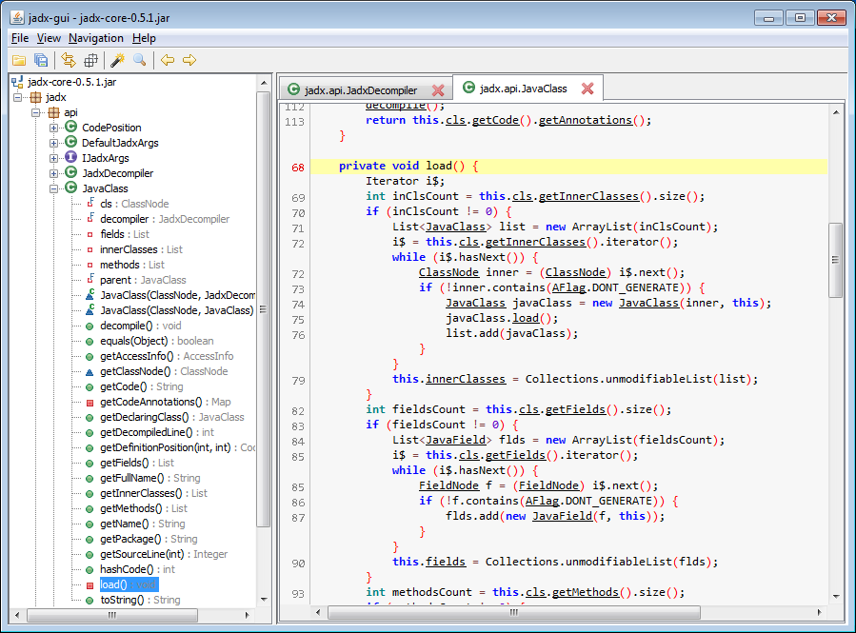
https://github.com/skylot/jadx
Notes:
Application secrets, reverse engineer application

Slide 41
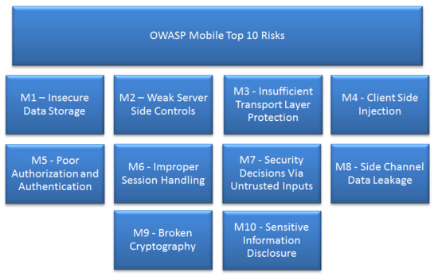
https://www.owasp.org/index.php/OWASP_Mobile_Security_Project
Notes:
OWASP Mobile top 10

Slide 42
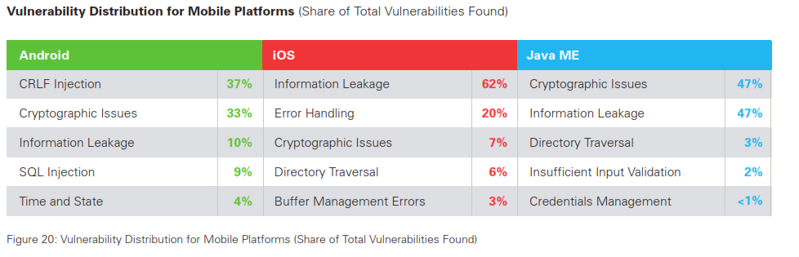
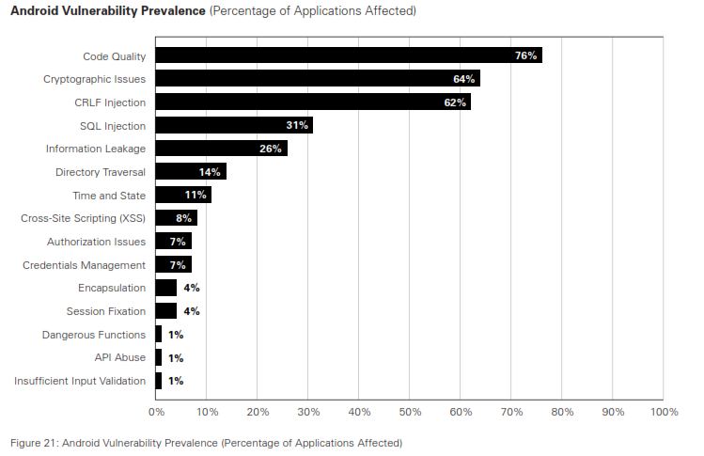
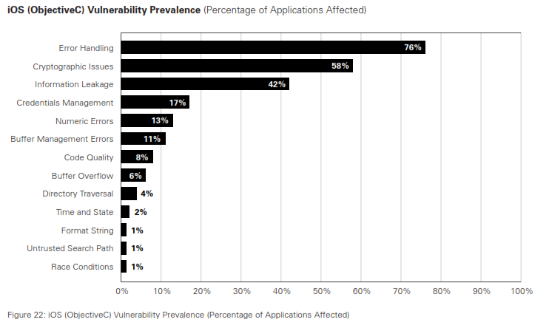
Notes:
Cryptographic vulns, keys in app, poor storage

Slide 43

https://www.flickr.com/photos/76074333@N00/317952268/
Notes:
Threat modeling! / SDL tool

Slide 44


Slide 45

https://www.flickr.com/photos/kalexanderson/6451988393/

Slide 46
References
The Most Dangerous Code in the World: Validating SSL Certificates in Non-Browser Software http://www.cs.utexas.edu/~shmat/shmat_ccs12.pdf
https://www.owasp.org/index.php/Testing_for_NoSQL_injection
https://blog.vpn.ac/a-story-of-imitation-and-security-done-wrong.html
http://www.troyhunt.com/2014/09/hack-your-api-first-learn-how-to.html

Slide 47
Resources
https://www.ssllabs.com/ssltest/
http://www.telerik.com/fiddler
http://www.telerik.com/fiddler/add-ons
https://portswigger.net/burp/proxy.html
https://www.owasp.org/index.php/OWASP_Zed_Attack_Proxy_Project
https://identityserver.github.io/Documentation/
Notes:
Metasploit / ZAP / Fiddler / Kali linux / Burp proxy

